Slide 1
Universitäres Institut akkreditiert nach HFKG
Institut universitaire accrédité selon la LEHE
Diagnosing 3S
Notes:
Recent paper
Not discuss everything. Mostly important for the question raised and idea of future directions and projects.

Slide 2
Methods

Slide 3
Line intersections
2
5
Rationale: Synesthetic forms should have less line intersections. This is due to a coherent form.
4
1
3
i.e. 3 crossings:
1-2 & 3-4
1-2 & 4-5
2-3 & 4-5

Slide 4
Line intersection method
Description: for each conditions:
Months (12 stimulus): 11 segments
Weekdays (7 stimulus): 6 segments
Numbers (10 stimuli): 9 segments
X 3 Repetitions
Speratedly by ID X Condition X repetition: compute sum of segment intersections
Divide by number of segments by conditions.
Compute average by ID. (Could do a sum, so if 0 in a conditions would not penalize the score).
=> Higher nubmer = more likely to have intersections between segments.

Slide 5
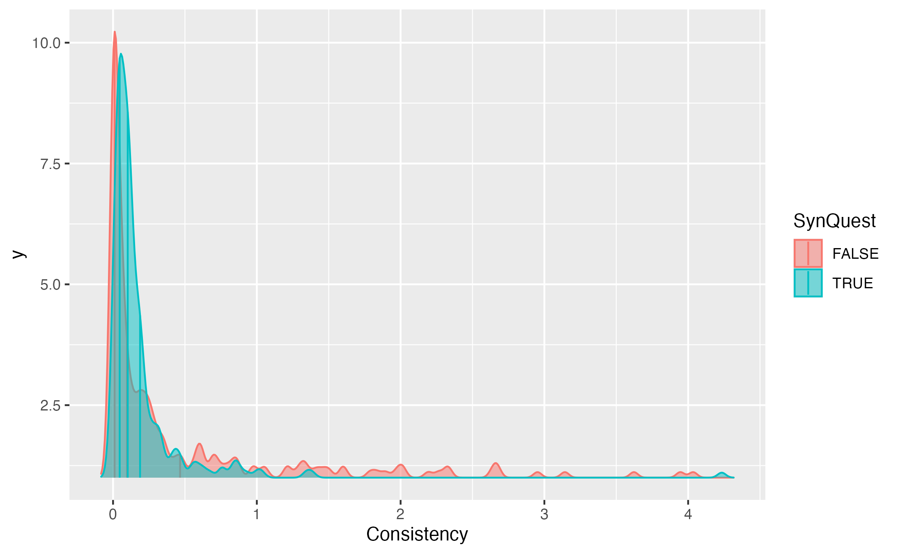
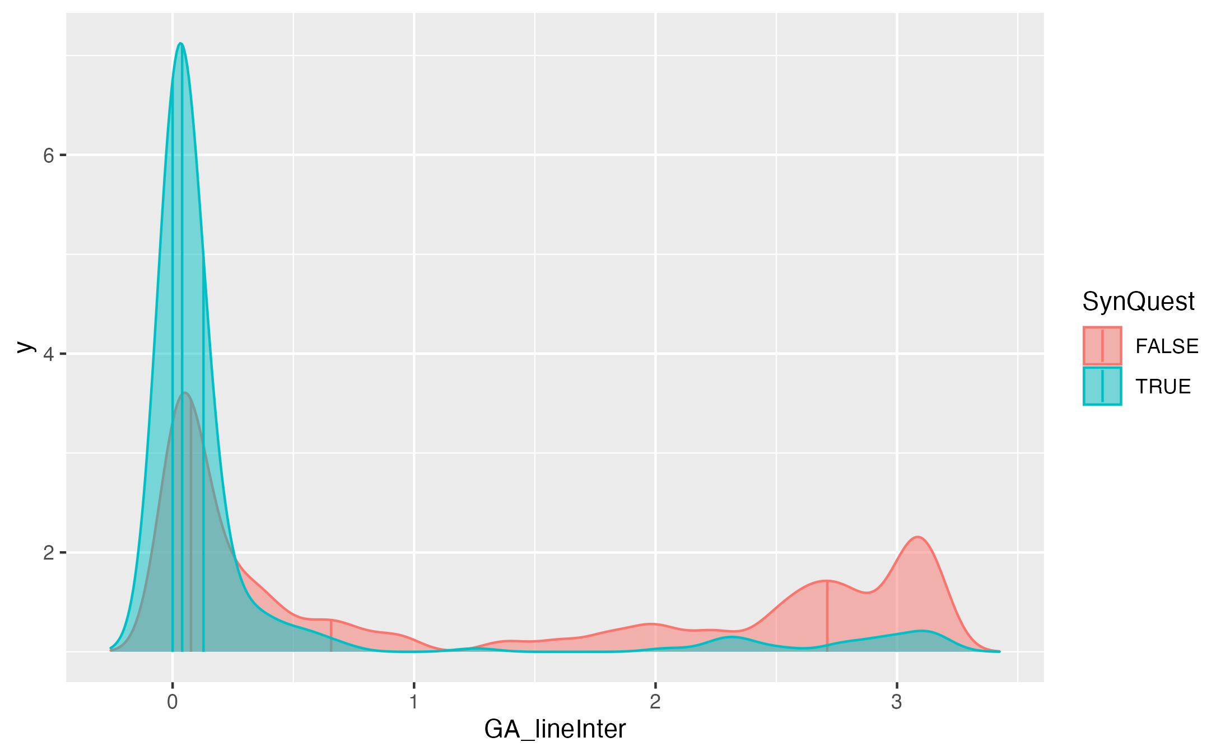
Consistency vs “Line intersection”
Median Syn
Median Syn
Median Ctl
Median Ctl
Notes:
Distributions should differ in median, not overlap.

Slide 6
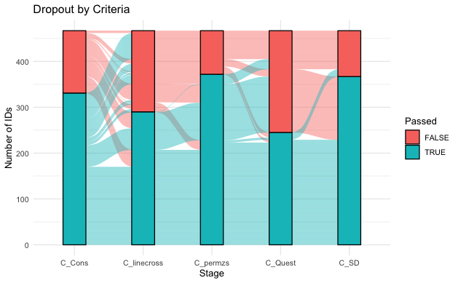
Comparing criteria
Only Ward Data

Slide 7
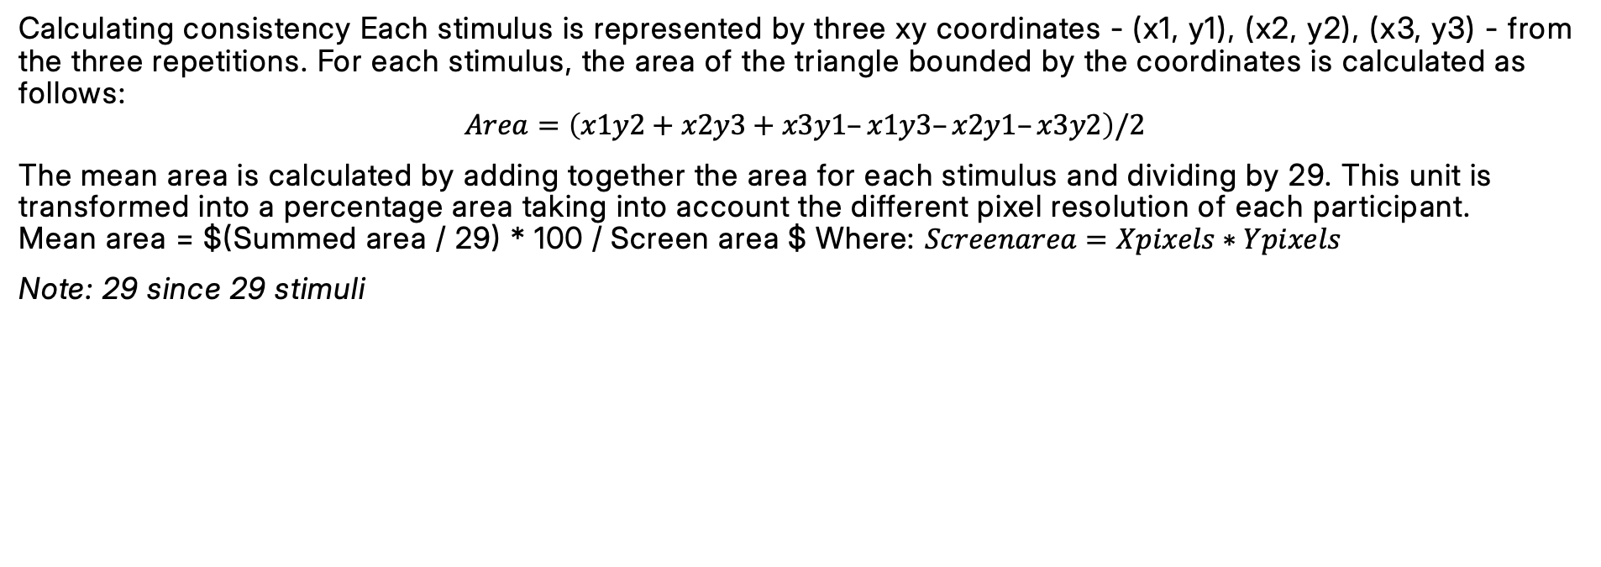
1. Compute Consistency:
Calculating consistency Each stimulus is represented by three xy coordinates - (x1, y1), (x2, y2), (x3, y3) - from the three repetitions. For each stimulus, the area of the triangle bounded by the coordinates is calculated as follows:
$$Area=\left(x1y2+x2y3+x3y1–x1y3–x2y1–x3y2\right)/2$$
The mean area is calculated by adding together the area for each stimulus and dividing by 29. This unit is transformed into a percentage area taking into account the different pixel resolution of each participant. Mean area = $(Summed area / 29) * 100 / Screen area $ Where: $Screenarea=Xpixels∗Ypixels$
Note: 29 since 29 stimuli

Slide 8
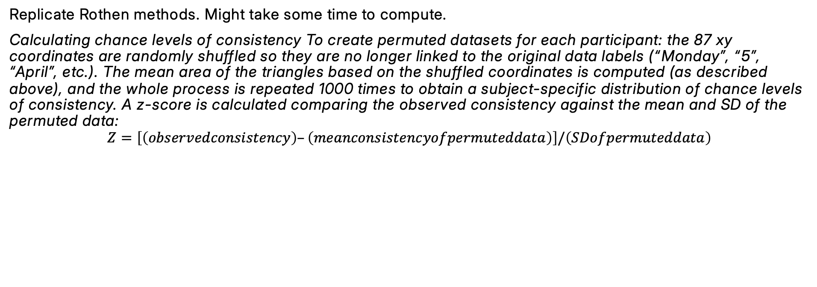
2. Compute Permuted consistency
Replicate Rothen methods. Might take some time to compute.
Calculating chance levels of consistency To create permuted datasets for each participant: the 87 xy coordinates are randomly shuffled so they are no longer linked to the original data labels (“Monday”, “5”, “April”, etc.). The mean area of the triangles based on the shuffled coordinates is computed (as described above), and the whole process is repeated 1000 times to obtain a subject-specific distribution of chance levels of consistency. A z-score is calculated comparing the observed consistency against the mean and SD of the permuted data:
$$Z=\left[\left(observedconsistency\right)–\left(meanconsistencyofpermuteddata\right)\right]/\left(SDofpermuteddata\right)$$

Slide 9
3. Compute SD as in Ward
As in Ward:
“Specifically, the standard deviation of the x-coordinates and/or the standard deviation of the y-coordinates (measured across all trials) should exceed a proposed value of 0.075 for a normalized screen with width and height of 1 unit.”
“A participant who produced a horizontal straight-line form would have a very low standard deviation in the y-coordinates but a high standard deviation in x-coordinates, and a participant with a vertical line would have the reverse profile. A participant with a circular spatial form would be high on both. A participant who clicks randomly around the screen would also be high on both x and y standard deviation, but would fail the consistency tests (the triangles would be large).”
[1] 0.2030271

Slide 10
5. Compute line intersections
4.2. Line intersections
Arbitrary threshold of 0.25.
GA_lineInter is the general average of all repetitions and conditions, of the chances that two segments within each Condition and repetition would cross. That is, for each IDXConditionXrepetition separatedly, we computed the number of segments that crosses in ordered stimuli (note the number of segment is the number of stimuli - 1), divided by the number of segments. This gives, for each IDXConditionXrepetition separately, the chances that two segments intersect. This chance is then averaged for each ID. This also means that conditions with more stimuli might have smaller averages (?). Could also compute the median.

Slide 11
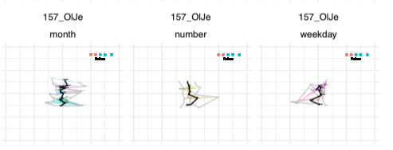
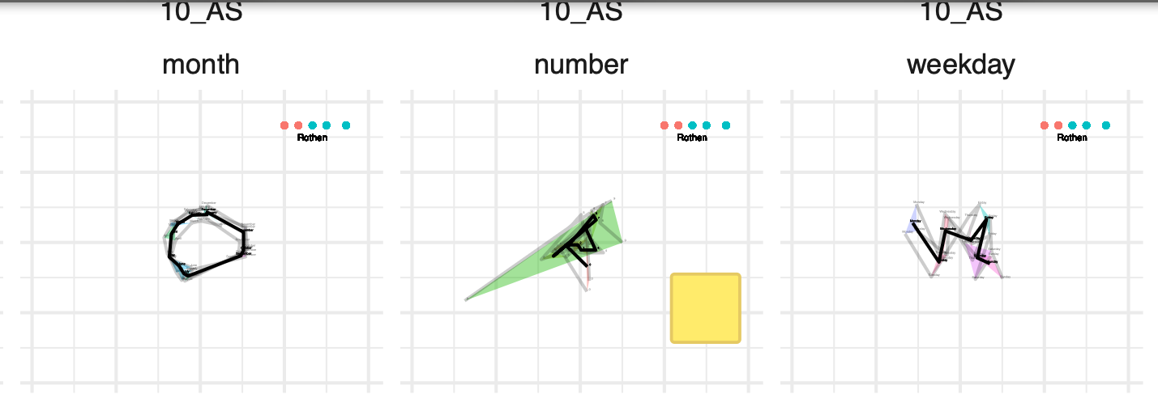
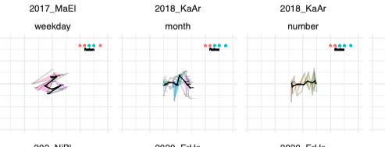
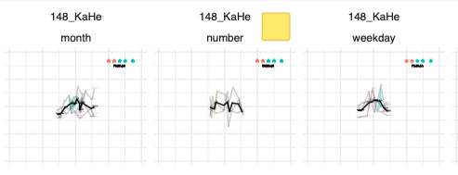
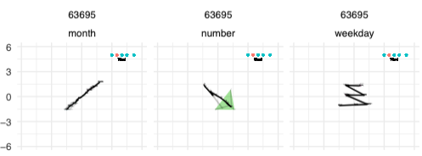
Examples I
Inconsistent but pass intersections

Slide 12
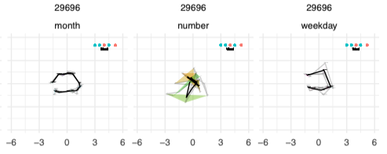
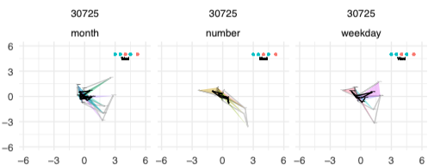
Examples II
Consistent do but not pass intersections

Slide 13
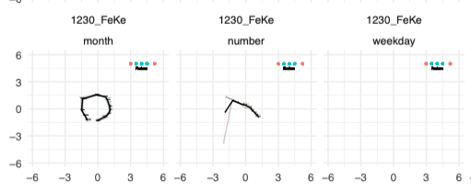
Examples III
No lines
Should the test be passed in all conditions ? (i.e. should sequence space synesthesia be diagnosed:
if months & weekdays & numbers
(conservative)
Or
if months | weekdays | numbers
(liberal)
Notes:
If liberal could sum instead of average the line intersections (so number = 0).

Slide 14
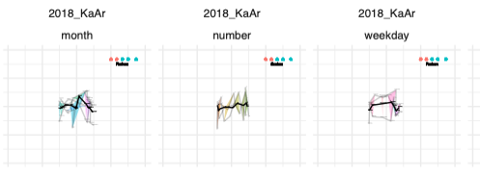
Example IV
Number line

Slide 16
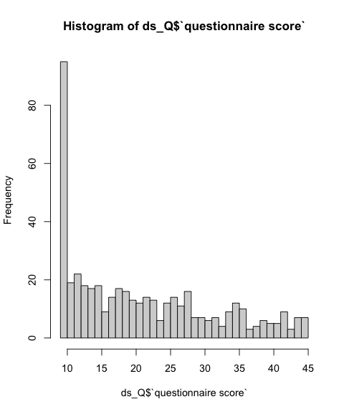
Discussion with NR
Questionnaire
Q1 . Some people routinely think about sequences as arranged in a particular spatial configuration (as in the examples below), do you think this might apply to you? (1=strongly agree, 5= strongly disagree) | Q2_numbers (1=present, 0=absent) | Q2_days (1=present, 0=absent) | Q2_months (1=present, 0=absent) | Q2_years (1=present, 0=absent) | Q2_letters (1=present, 0=absent) | Q2_temperature (1=present, 0=absent) | Q2_height (1=present, 0=absent) | Q2_weight (1=present, 0=absent) | Q3 Where do you tend to routinely experience these sequences? (1= in the space outside my body; 2= on an imagined space that has no real location; 3= inside my body; 4= this doesn't apply to me!)
Q4_colours (1=present, 0=absent) | Q4_shading (1=present, 0=absent) | Q4_2D (1=present, 0=absent) | Q4_3D (1=present, 0=absent) | Q4_perspective (1=present, 0=absent) | Q4-blocks-or-tiles (1=present, 0=absent) | Q4_font (1=present, 0=absent)
Q5 Before doing this experiment, I always thought about NUMBERS as existing in a particular spatial sequence (1= strongly agree; 5= strongly disagree) | Q6 Before doing this experiment, I always thought about DAYS OF THE WEEK as existing in a particular spatial sequence (1= strongly agree; 5= strongly disagree) | Q7 Before doing this experiment, I always thought about MONTHS OF THE YEAR as existing in a particular spatial sequence (1= strongly agree; 5= strongly disagree) | Q8 I use this way of thinking about spatial sequences in my everyday life (1= strongly agree; 2= strongly disagree) | Q9 When doing the experiment, I didn't have any strong intuition as to where to put the NUMBERS (1= strongly agree; 5= strongly disagree) | Q10 When doing the experiment, I didn't have any strong intuition as to where to put the DAYS OF THE WEEK (1= strongly agree; 5= strongly disagree) | Q11 When doing the experiment, I didn't have any strong intuition as to where to put the MONTHS OF THE YEAR (1= strongly agree; 5= strongly disagree) | Q12 This experiment didn't really make much sense to me (1= strongly agree, 5= strongly disagree) | Q13 Feel free to enter any comments here. E.g. what strategy did you use? Do you want to clarify any of the above answers?

Slide 17
Question
How to compare criteria?
Add other data?
How to set cutoffs?
Average or sum conditions?
Random walk (possible issue with repetitions)?

Slide 19
Data | Categories | Consistency | AUC | Sensitivity | Specifity | Opt. Cutoff
Ward | group | Area | 55.4 | 92.85 | 33.48 | 0.021
Ward | Syn Quest | Area | 49.8 | 90.61 | 30.18 | 0.0219
Ward | Syn NR | Area | 52.7 | 80.48 | 40.25 | 0.16
Ward | group | Intersections | 76.8 | 91.67 | 54.88 | 0.55
Ward | Syn Quest | Intersections | 76.6 | 84.89 | 62.16 | 0.246
Ward | Syn NR | Intersections | 71.8 | 84.14 | 56.88 | 0.092
NR | group | Area | 74.6 | 84.84 | 70.27 | 0.200
NR* | group | Area | 70.3 | 79.16 | 70.27 | 0.200
NR | group | Intersections | 46.8 | 45.45 | 70.27 | 0.025
NR* | group | Intersections | 63.6 | 62.5 | 70.27 | 0.0257
* Excluded 10 ID with 1 condition responded in the same position
Notes:
Why those differences?
Sampling:
NR:
“The potential synesthetes were selfselected by filling in an online questionnaire that is linked to our research group (www.sussex.ac.uk/synaesthesia).”
Ward:
“There were 252 self-referred sequence-space synaesthetes who completed the test (202 females, 44 males, 6 other; mean age = 37.313 years, S.D. = 13.845). These participants had contacted our research group via our website (www.sussex.ac.uk/synaesthesia) and were subsequently invited to take the test.”

Slide 20
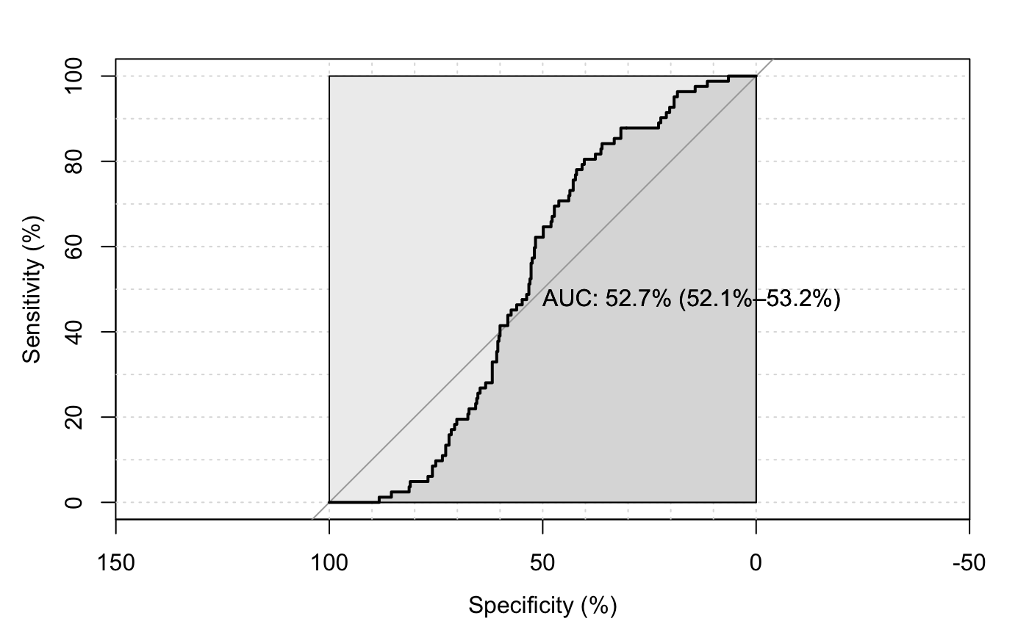
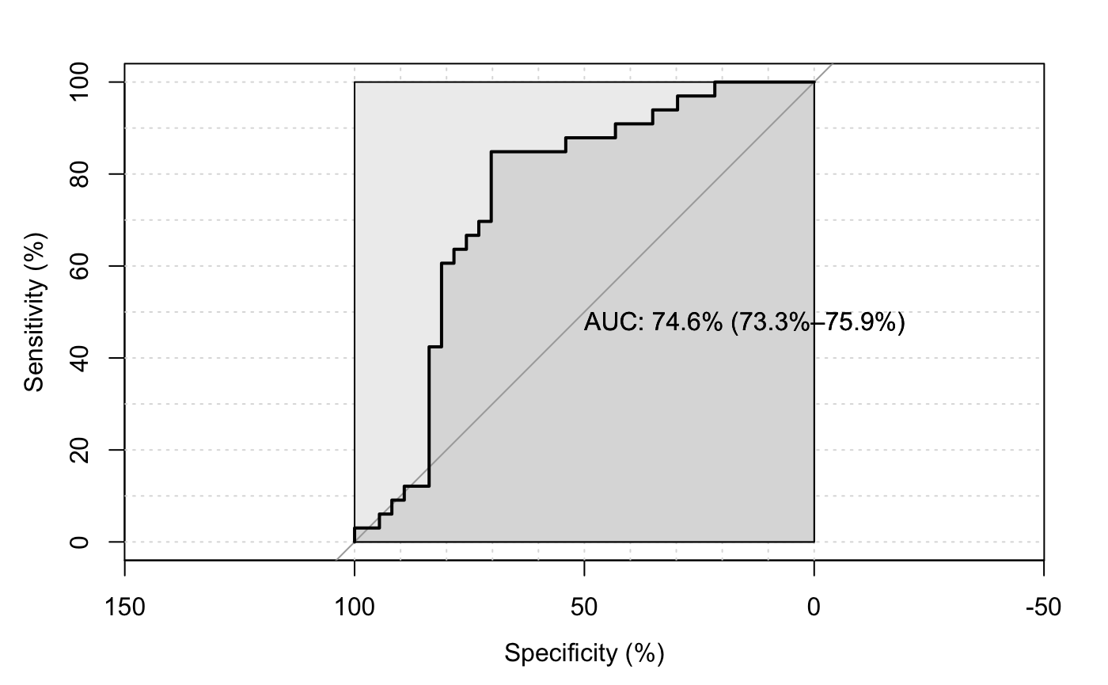
Difference between datasets
Area consistency in Ward vs NR data
Ward data (Synesthetes redefined based on selected questions) NR data:
threshold sensitivity specificity
0.1638364 80.4878 41.75824
threshold | sensitivity | specificity
0.2002146 | 84.84848 | 70.27027
Notes:
Why this difference?

Slide 22
 |  | Questionnaire
 | SynGroup | FALSE | TRUE
Group | FALSE | 40.26% | 5.78 % “unbeknown synesthetes/liars”
 | TRUE | 7.28 % “liars/other types of syn” | 46.68 %

Slide 23
 |  | SynGroup | = | FALSE
 |  | SynQuest
 |  | FALSE | TRUE
Syn Area | FALSE | 16.059957 | 2.141328
 | TRUE | 24.197002 | 3.640257
 |  | SynGroup | = | TRUE
 |  | SynQuest
 |  | FALSE | TRUE
SynArea | FALSE | 4.710921 | 13.704497
 | TRUE | 2.569593 | 32.976445
 |  | SynGroup | = | FALSE
 |  | SynQuest
 |  | FALSE | TRUE
SynLine | FALSE | 26.124197 | 2.35546
 | TRUE | 14.132762 | 3.426124
 |  | SynGroup | = | TRUE
 |  | SynQuest
 |  | FALSE | TRUE
SynLine | FALSE | 3.426124 | 5.567452
 | TRUE | 3.85439 | 41.11349
Notes:
If Control, and also Syn from the qeustionnaire, the Area consistency would lead to ~10 % more false positives than intersections.
If group synesthetes confirmed by the questionnaire, the area will lead to ~8% more false negatives.
Note: took the Ward questionnaire threshold.
Note 2: took also the consistency recalculated threshold (based on ROC).

Slide 24
GLM ?

Slide 25
Vielen Dank für Ihre Aufmerksamkeit! Merci pour votre attention ! Thank you for your attention!
Universitäres Institut akkreditiert nach HFKG
Institut universitaire accrédité selon la LEHE

